Slide 1





ACO Erasure Coding
WITH
Group 1
Maurya Aryan Swaminath (210595)
Depanshu Sahu (210316)
Aditya Ajmera (210056)

Slide 2
Problem Statement
Achieving both data reliability and energy efficiency in routing remains a critical challenge IoT networks. As IoT devices typically operate with limited power resources, optimizing energy consumption is essential for extending network lifespan. However, this must be balanced with ensuring reliable data transmission, as packet loss during communication can compromise the overall performance and integrity of the network. Therefore, the key issue is to develop a routing protocol that minimizes data loss while maintaining energy efficiency during data transmission.
1

Slide 3
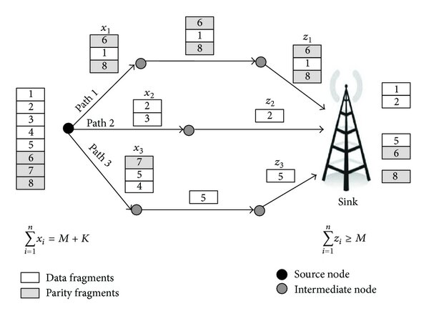
Erasure Coding
A fault tolerance technique where data is split into smaller parts and encoded with extra parity pieces, allowing recovery even if some parts are lost
How it works ?
Split data into M parts.
Add K parity parts and send K+M packets.
Recover original data from any M out of K+M parts.
Key Benefits
Less overhead compared to replication
Data recovery even after multiple packet loss
Challenge
Requires more computation resources for encoding and decoding
Image Courtesy: [1]
2

Slide 4
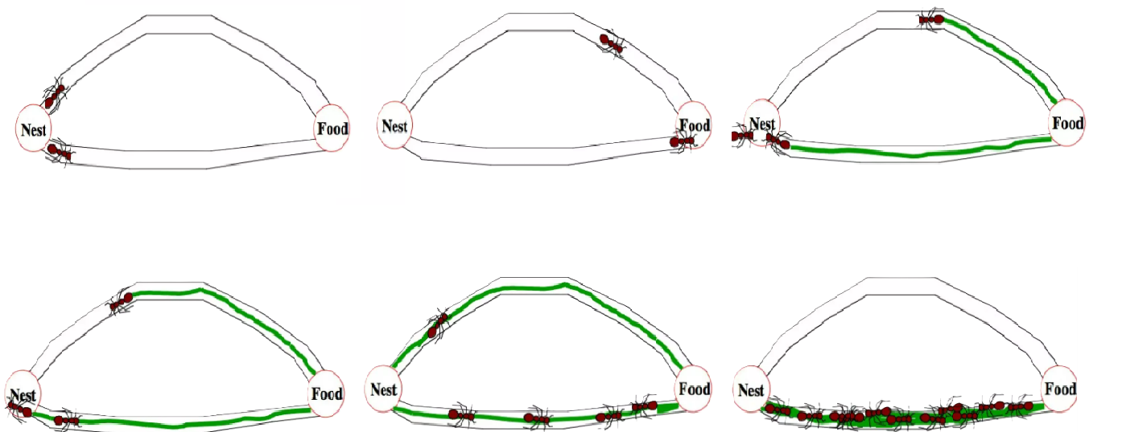
Ant Colony Optimization (ACO)
Two ants start with equal probability of going on each path
Ant on shorter path has shorter to-and-fro time from nest to food
Density of pheromones is higher on shorter path because of two passes by ant
Next ant takes higher pheromone path (i.e. shorter path)
Over many iterations, more ants use higher pheromone path
After some time, shorter path is almost exclusively used
Image courtesy: [2]
3

Slide 5
Ant Colony Optimization (ACO)
Initialize the sensor node energy levels and pheromones in table
Send multiple ants (data packet) from source node
Ant selects next hop based on pheromones, distance and energy
This ant follows the previous path and updates pheromones
Ant after reaching base station, generates backward ant
The ant updates the energy level, hop, distance in its table
One iteration ends when the backward ant reaches source node
The optimal path converges after multiple iterations
Send ants periodically to adapt to changes in network topology
4

Slide 6
Related Work
A Clustering Routing Algorithm Based on Improved Ant Colony Optimization Algorithms for Underwater Wireless Sensor Networks [3]
This paper aims to address the problem of energy consumption in Underwater Wireless Sensor Networks (UWSNs)
Proposes an energy-efficient clustering routing algorithm based on an improved Ant Colony Optimization (ACO) algorithm
Optimizes the cluster head selection based on the residual energy of nodes and the distance factor
Modifies evaporation parameter for the pheromone update mechanism, and the ant searching scope in the ACO
Improvement of the ACO based on the consideration of the residual energy of nodes and the distance factor
5

Slide 7
Related Work
A novel energy‑efficient and reliable ACO‑based routing protocol for WSN‑enabled forest fires detection [4]
This paper addresses the problem of energy efficiency and reliability for forest fires monitored by a distributed bandwidth-constrained Wireless Sensor Network (WSN)
They propose a novel Energy-efficient and Reliable ACO-based Routing Protocol (E-RARP) for WSNs
It guarantees high quality communication paths in terms of energy efficiency and ensures the communication reliability
The algorithm is devised using four new parameters in addition to the pheromone which are hop count, counter of weak-links, neighbor nodes count and residual energy
It is a robust routing protocol for delay-intolerant applications such as forest fire detection
6

Slide 8
Related Work
Fast Erasure Coding for Data Storage: A Comprehensive Study of the Acceleration Techniques [5]
In this paper many techniques to improve erasure code computation efficiency has been proposed
Most of the discussed Erasure codes use XOR-ing and matrix multiplication
Uses XOR reduction and caching management techniques, and apply XOR level vectorization
Shows that Cauchy Reed Solomon (CRS) algorithm is more efficient than Reed Solomon algorithm
Concludes that using vectorization improves the computer efficiency in the calculations
7

Slide 9
Related Work
A novel bio-inspired routing algorithm based on ACO for WSNs [6]
This paper aims to optimize the traditional ACO algorithm for route discovery for mobile devices
Introduces a stability factor based on the average mobility and speed of the nodes
Considers parameter like stability, energy and route length when deciding the next hop of ants
Shows improved performance in terms of best cost and in the energy consumption of the nodes per transmission
It is shown to converge to best route faster than the traditional ACO algorithm
8

Slide 10
Related Work
An Energy Efficient Routing Protocol Based on Improved Artificial Bee Colony Algorithm for Wireless Sensor Networks [7]
This paper introduces an improved Artificial Bee Colony (ABC) algorithm combined with Ant Colony Optimization (ACO) to enhance energy efficiency under limited power
The improved ABC algorithm selects optimal Cluster Heads (CH), while ACO handles the routing between CHs
Performance was measured on network lifetime (75% alive nodes), stability period and throughput
By focusing on energy consumption and optimizing routes through iterative algorithms, it significantly reduces node energy consumption and prolongs network lifetime
9

Slide 11
Related Work
Energy Efficient Cluster-Based Routing Protocol for WSN using Butterfly Optimization Algorithm and Ant Colony Optimization [8]
The Butterfly Optimization Algorithm (BOA) is employed to choose an optimal cluster head from a group of nodes
The cluster head selection is optimized by the residual energy of the nodes, distance to the neighbors, distance to the base station and node degree
The route between the cluster head and the base station is identified by using Ant Colony Optimization (ACO), it selects the optimal route based on the distance, residual energy and node degree
The performance was measured on various metrics including FND (First Node Dead), number of alive nodes and average energy consumption
The proposed methodology had a higher network lifetime and higher network performances compared to LEACH
10

Slide 12
Related Work
Accelerating XOR-Based Erasure Coding Using Program Optimization Techniques [9]
Uses XOR-based matrix multiplication optimization techniques, to reduce the computation overhead required for erasure code encoding
Uses Straight-line programs (SLPs) from program optimization and the grammar compression algorithm RePair
Performance was measured on the basis on the basis of throughput rate
A good solution for large-scale applications, but is not efficient for smaller scale ones
11

Slide 13
Related Work
Erasure Coding Based Efficient Communication for Internet of Things [10]
Develops an energy-efficient communication protocol for IoT ad hoc networks
Proposed algorithm: VCast, which uses erasure coding to split messages into multiple smaller packets
VCast improves upon the UCast protocol by using packets that would have otherwise been discarded, resulting in larger hop distances and more efficient message propagation
Shortcoming: Requires relatively high node density to work effectively, performing poorly in low-density networks with lower message delivery ratios than UCast
12

Slide 14
Related Work
E-ReInForMIF Routing Algorithm Based on Energy Selection and Erasure Code Tolerance Machine [11]
Develops an energy-efficient routing algorithm for wireless sensor networks (WSNs) to reduce data loss and balance energy consumption
Proposed Algorithm: E-ReInForMIF algorithm integrates erasure coding and energy-aware node selection in the traditional ReInForM
Compared to the traditional algorithm, it adds an energy-balancing mechanism and a fault-tolerant coding scheme, ensuring that even with some packet loss, the original data can be reconstructed
Shortcoming: The energy gains come at the cost of relatively higher energy consumption from using erasure coding. It performs better in dense networks but performs poorly in sparsely populated networks
13

Slide 15
Related Work
Multipath Routing with Erasure Coding in Underwater Delay Tolerant Sensor Networks [12]
Improves reliable data delivery in Underwater Sensor Networks (UWSNs) by reducing packet loss through a multipath routing protocol with Erasure Coding (ECMR)
Proposed Algorithm: The ECMR algorithm combines multipath routing with erasure coding, splitting packets into smaller blocks and distributing them across multiple paths to improve data reliability
ECMR uses Bayes’ theorem to allocate erasure-coded blocks more effectively across paths, while accounting for path reliability
Shortcoming: ECMR depends on the availability of multiple paths, making it less effective in networks with sparse connectivity or fewer routing options
14

Slide 16
Comparison
Research paper | Routing Algorithm | Erasure Coding Algorithm | Improves Energy Efficiency | Data loss Reduction | Compared with | Conclusion
Ant Colony Optimization Algorithms for Underwater WSN | Ant colony optimization clustering routing (ACOCR) [modified ACO] | No | Yes | Yes | LEACH, LEACH-ANT, CCUWSN, DUCS, etc. | Gives heuristic to select Cluster Head. Accounts for Energy in ACO for underwater WSN
Energy efficient cluster based routing protocol for WSN using butterfly optimization algorithm and ant colony optimization | Butterfly Optimization Algorithm (BOA), Ant Colony Optimization (ACO) | No | Yes | Yes | Some existing methods LEACH, ALOC and FLION. | Improves fitness function of BOA for optimal cluster head selection, and reduces packet drop ratio
An Energy Efficient Routing Protocol Based on Improved Artificial Bee Colony Algorithm for Wireless Sensor Networks | improved Artificial Bee Colony (ABC), optimized fuzzy-C means and improved Ant Colony Optimization (ACO) | No | Yes | No | LEACH-C, FIGWO and ABC-SD | Improves network lifetime by balancing energy among cluster heads, and optimized intra cluster head selection
15

Slide 17
Comparison
Research paper | Routing Algorithm | Erasure Coding Algorithm | Improves Energy Efficiency | Data loss Reduction | Compared with | Conclusion
A novel energy-efficient and reliable ACO-based routing protocol for WSN-enabled forest fires detection | Energy efficient and Reliable Routing Protocol (E-RARP) [modified ACO] | No | Yes | Yes | LB-CR-ACO, HDMRP, EAQHSeN | Modifies ACO to add more features and improve the reliability and energy efficiency
Multipath Routing with Erasure Coding in Underwater Delay Tolerant Sensor Networks | ECMR - erasure coding based multipathrouting | Simulation | No | Yes | DTLSR, DTLSR-LW and M-DTLSR-LW | Simulates if the data can or cannot be recovered from the received packets using Bayes Probability for packet loss.
Erasure Coding Based Efficient Communication for Internet of Things | VCast improved upon UCast by Erasure Coding based communication | does not specify | Yes | No | TCast and UCast | Better energy efficiency while achieving similar covered area
16

Slide 18
Comparison
Research paper | Routing Algorithm | Erasure Coding Algorithm | Improves Energy Efficiency | Data loss Reduction | Compared with | Conclusion
E-ReInForMIF Routing Algorithm Based on Energy Selection and Erasure Code Tolerance Machine | E-ReInForMIF algorithm | Based on the Quantitative Evaluation Mechanism of Node Energy Consumption | Yes | Yes | ReInForM algorithm with Forward Error Correction (FEC) | Improves the multipath routing algorithm by combining the EC fault-tolerant machine and node residual energy sorting selection
A novel bio-inspired routing algorithm based on ACO for WSNs | ACO | No | Yes | No | traditional ACO algorithm | For mobile nodes, considering both the node mobility and the existing energy of the nodes, anoptimal route is given by the algorithm
17

Slide 19
Comparison
Research paper | Routing Algorithm | Erasure Coding Algorithm | Improves Energy Efficiency | Data loss Reduction | Compared with | Conclusion
Fast Erasure Coding for Data Storage: A Comprehensive Study of the Acceleration Techniques | NA | Reed Solomon (RS), Cauchy Reed Solomon (CRS) | NA | Yes | Vectorized XOR-based CRS, Vectorized RS | Provides methods for vectorization and reducing the number of XOR operations reduce the computation energy requirement.
Accelerating XOR-Based Erasure Coding using Program Optimization Techniques | NA | Straign Line Programs (SLP) by XorRePair, reducing memory access by XOR fusion, | Yes | No | Intel's high performance lib ISA-L | Improves performace by XOR based multiplication using grammar compression algorithms
18

Slide 20
Proposed Method
We propose an Energy-Efficient ACO Algorithm with Erasure Coding (EC) to address energy efficiency and data reliability issues in IoT network routing.
Algorithm: We aim to encode the data to be sent using simple Erasure Codes and use ACO as the routing algorithm with some modifications.
ACO Modifications for Energy Efficiency: Heuristic factors and pheromone updates are adjusted to favour energy-saving routes while maintaining stable communication between cluster heads and the base station.
Cauchy Reed-Solomon EC Algorithm: IoT networks often deal with small data packets. The Cauchy Reed-Solomon algorithm is particularly efficient for such scenarios, as it allows for faster encoding and decoding with minimal overhead
This approach is expected to improve data reliability and optimize energy usage over traditional ACO algorithm.
19

Slide 21
Plan
Set up and initialize the WSN network infrastructure components
Implement the basic ACO algorithm framework structure
Modify the ant routing selection function logic parameters
Implement the erasure coding mechanism for redundancy
Fully integrate both algorithms for seamless operation
Create a detailed visualization of the algorithm's process flow
Run simulations under varying packet loss probablities
Compare the results with the basic ACO algorithm performance metrics
20

Slide 22
Deliverables
Python code for the algorithm implementation
Detailed report on the algorithm and its performance
Simulation video demonstrating the algorithm in action
Energy-efficient and data reliability comparisons with metrics
21

Slide 23
References
[1] https://www.researchgate.net/figure/Mechanism-of-Erasure-Coding_fig1_4310455
[2] https://www.slideshare.net/slideshow/ant-colony-optimization-aco- 91879003/91879003#2
[3] https://ieeexplore.ieee.org/abstract/document/9144196
[4] https://www.mdpi.com/1999-4893/13/10/250
[5] https://www.sciencedirect.com/science/article/pii/S1570870520306739
[6] https://www.beei.org/index.php/EEI/article/view/1492/1083
[7] https://ieeexplore.ieee.org/abstract/document/9144196
[8] https://www.sciencedirect.com/science/article/pii/S1570870520306739
[9] https://dl.acm.org/doi/abs/10.1145/3458817.3476204
[10] https://ieeexplore.ieee.org/abstract/document/9275842
[11] https://www.mdpi.com/2079-9292/12/11/2408
[12] https://ieeexplore.ieee.org/abstract/document/9348679
22

Slide 24
Thank
You

